Slide 1
Loops

Slide 2
what it means for an object to be iterable?
An iterable is anything you’re able to loop over.
Examples:
Iterable are string, list, tuple, dict, set, and frozenset types.
file = open(“somefile.txt”)
next(file)
for lines in file …

Slide 3
What is an iterator?
An iterator is the object that does the actual iterating.
If an object is iterable, it can be passed to the built-in Python function iter(), which returns something called an iterator. Iterators help make more more memory-efficient code.

Slide 4
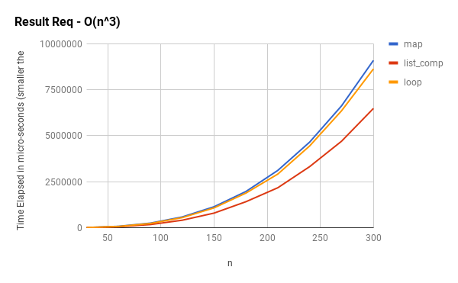

Slide 5
summation = 0
for i in range(100000000):
summation = summation + i
each steps:
Dereference summation (find the place in memory that is associated with the variable summation and read the data there)
Read that data to figure out the type of summation (in this case, it’s an integer).
Dereference i
Read that data to figure out the type of i (in this case, it’s an integer).
Lookup how it should interpret + given that summation is an integer and i is an integer.
Remember: if summation and i were strings, it wouldn’t be doing addition, it would be concatenating! And because integers and floating point numbers are different things from the perspective of a computer, if i were an integer and summation were a floating point number, + would actually require (a) converting i to a floating point number, then (b) adding the floating point version of i to summation.
Compile low-level binary code (referred to as “machine code”) that can be read by the computer’s processor to tell it to execute an addition of two integers AND checks for integer overflows.
Run that code.

Slide 6
List comprehensions perform better here because they don’t need to load the append attribute off of the list and call it as a function.
Instead, in a comprehension, generate a specialial LIST_APPEND bytecode to append onto the result list.

Slide 7
This is the for loop
list_a = [1, 2, 3, 4]
list_b = [2, 3, 4, 5]
common_num = []
for a in list_a:
for b in list_b:
if a == b:
common_num.append(a)
list_a = [1, 2, 3, 4]
list_b = [2, 3, 4, 5]
common_num = [
for value1 in list_a
for value2 in list_b
if value1 == value2
common_num.append(a)
]
List comprehension

Slide 8
array([ 0, 1, 2, ..., 999997, 999998, 999999])
%%timeit
b = numbers.copy()
for i in range(len(b)):
b[i] = numbers[i] * 2
357 ms ± 10.3 ms per loop
import numpy as np
numbers = np.arange(1000000)
numbers
%%timeit
b = numbers * 2
1.09 ms ± 40.6 µs per loop

Slide 9
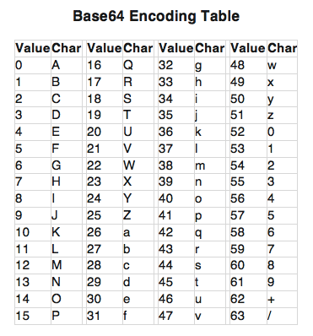
Encoding and decoding Base64
Take the ASCII value of each character in the string
Calculate the 8-bit binary equivalent of the ASCII values
Convert the 8-bit chunks into chunks of 6 bits by simply re-grouping the digits (Base64 characters only represent 6 bits of data) mind the padding.
Convert the 6-bit binary groups to their respective Base64 decimal values.Using a base64 encoding table, assign the respective base64 character for each decimal value.
convert these decimals into the appropriate Base64 character using the Base64 conversion table
80, 121, 116, 104, 111, 110
'01010000', '01111001', '01110100', '01101000', '01101111', '011101110'
101000 011110 011110 100110 100011 011111 101110
20 7 37 52 26 6 61 46
UHl0aG9u
ord()
bin(ord(x))[2:]
grouping.join(tuple(binary)) split every 6 (+ padding if needed)
Find the integer value of the eg: 101110 and compare to the table
Notes:
0b is like the 0x on your hexNumber; it's an indication that the number is in a certain base
The ord() function returns an integer representing the Unicode character.
the bin() method converts and returns the binary equivalent of a given integer.
Because Base64 is a six-bit encoding, and because the decoded values are divided into 8-bit octets on a modern computer, every four characters of Base64-encoded text (4 sextets = 4*6 = 24 bits) represents three octets of unencoded text or data (3 octets = 3*8 = 24 bits). This means that when the length of the unencoded input is not a multiple of three, the encoded output must have padding added so that its length is a multiple of four.

Slide 10
how do you convert 8-bit binary numbers into their ASCII characters?

Slide 11
References
https://www.kdnuggets.com/2019/06/speeding-up-python-code-numpy.html
https://www.practicaldatascience.org/html/performance_understanding.htm
https://treyhunner.com/2016/12/python-iterator-protocol-how-for-loops-work/l
https://treyhunner.com/2018/06/how-to-make-an-iterator-in-python/
https://www.practicaldatascience.org/html/performance_understanding.html
https://github.com/treyhunner/lazy-looping
https://www.youtube.com/watch?v=q8czHnhcVGE

